Slide 1

Frozen Sets and Dictionary

Slide 2
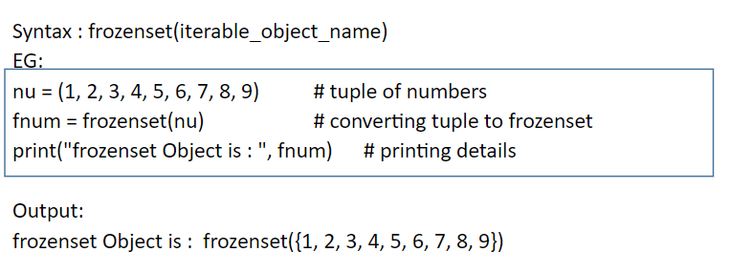
Definition
The frozenset() is an inbuilt function in Python which takes an iterable object as input and makes them immutable. Simply it freezes the iterable objects and makes them unchangeable.
he frozensets are immutable which means that elements from the frozenset cannot be added or removed once created.

Slide 3
Dictionary
Dictionaries are used to store data values in key:value pairs.
A dictionary is a collection which is ordered*, changeable and do not allow duplicates.
Creating dictionary
Dict_name = {Key : value }

Slide 4
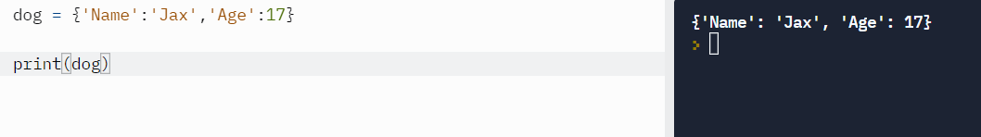
Example
Dog = {‘Name’ : ‘Jax’, ‘Age’:17}

Slide 5
continue
Adding an item
  Dict_name[key] = value
Changing value of an item
  Dict_name[existing_key] = new_value
To get number of items in a dictionary
  len(Dict_name)
Print only keys:
  Dict_name.keys()
Print only values
  Dict_name.values()

Slide 6
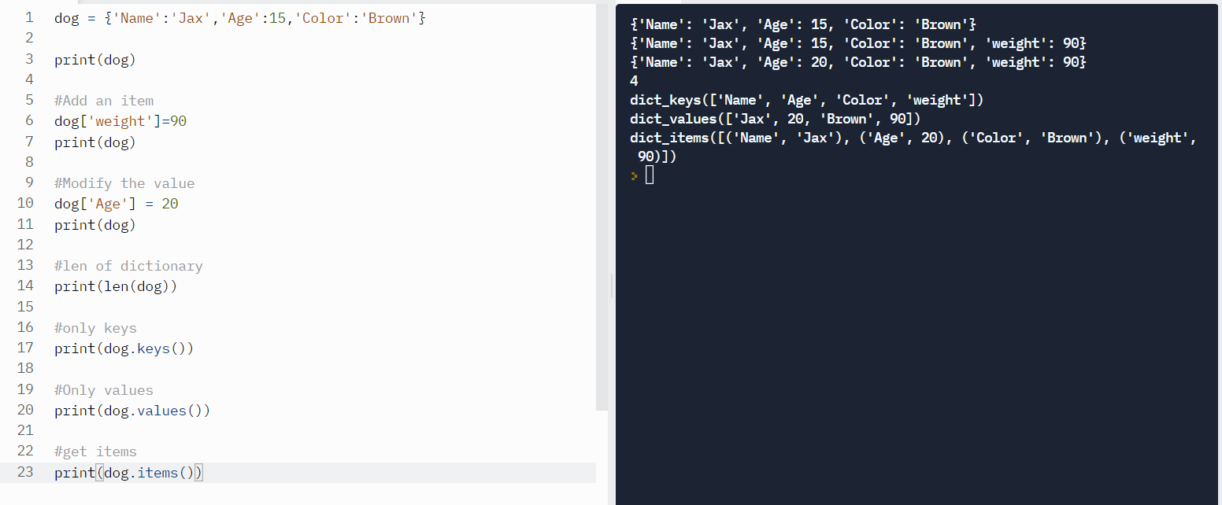
Dictionary

Slide 7
Removing
pop – removes the item with specified key name
popitem – removes the last inserted item.
Del – deletes the item with specified key name
Clear - clears all the items in the dictionary

Slide 8
